Slide 1
강진욱 201515246
공필상 201315164
Avengers project

Slide 2
Contents
Project topics
1
System structure
2
3
Development Environment

Slide 3
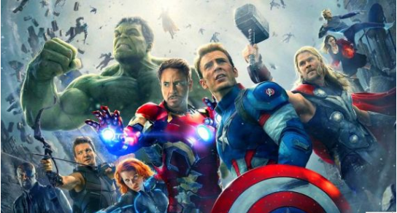
1
Project topics
Avengers project

Slide 4
2
System structure
Contest crawling
Web and DB build
Provide information
Host URL
Term
Login
Comments
Posts
manage overlap
Main : 강진욱
Sub : 공필상
Main : 공필상
Sub : 강진욱

Slide 5
2
System structure
Xpath
current url
Click, back
selenium
crawling
requests
re
Bring source code from URL page
Make parser to each tag
pymysql
Connect to DB
If information are overlapped then break

Slide 6
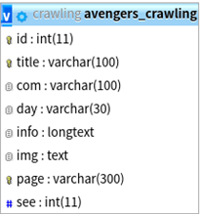
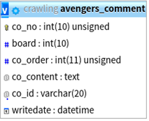
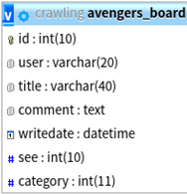
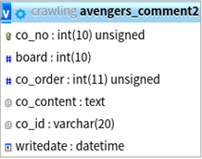
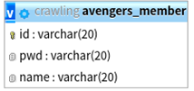
2
System structure
Contest
DB
Free board
Comment
Login

Slide 7
2
System structure
Using SQL statement
past contests are hide
Contest
Web
Free board
Login
Free communication
Sign up
Check ID
Permit only Users

Slide 8


2
System structure
Crawling Page
위비티 https://www.wevity.com/
씽굿 https://www.thinkcontest.com/

Slide 9
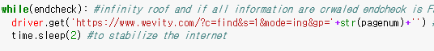
2
System structure
Enter page
위비티 https://www.wevity.com/
씽굿 https://www.thinkcontest.com/

Slide 10
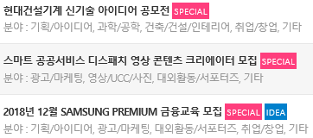
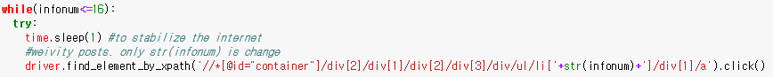
2
System structure
Click list

Slide 11
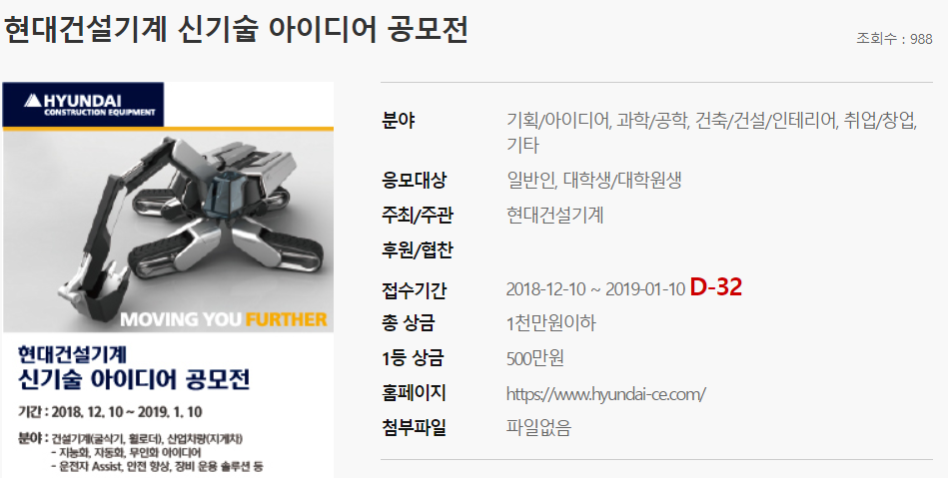
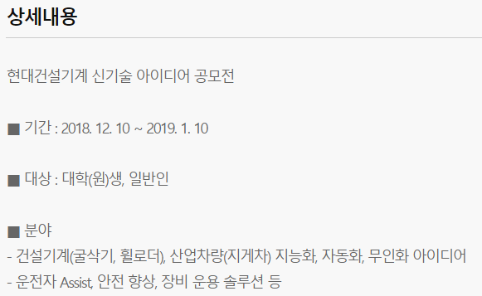
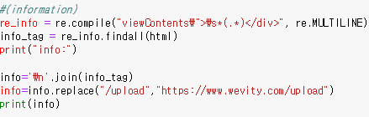
2
System structure
Crawling info

Slide 12
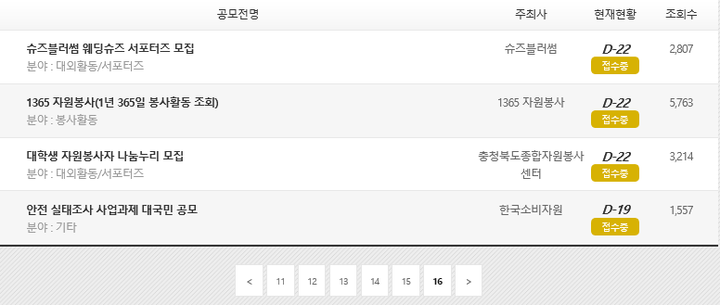
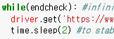
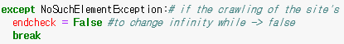
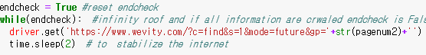
2
System structure
All page are done

Slide 13
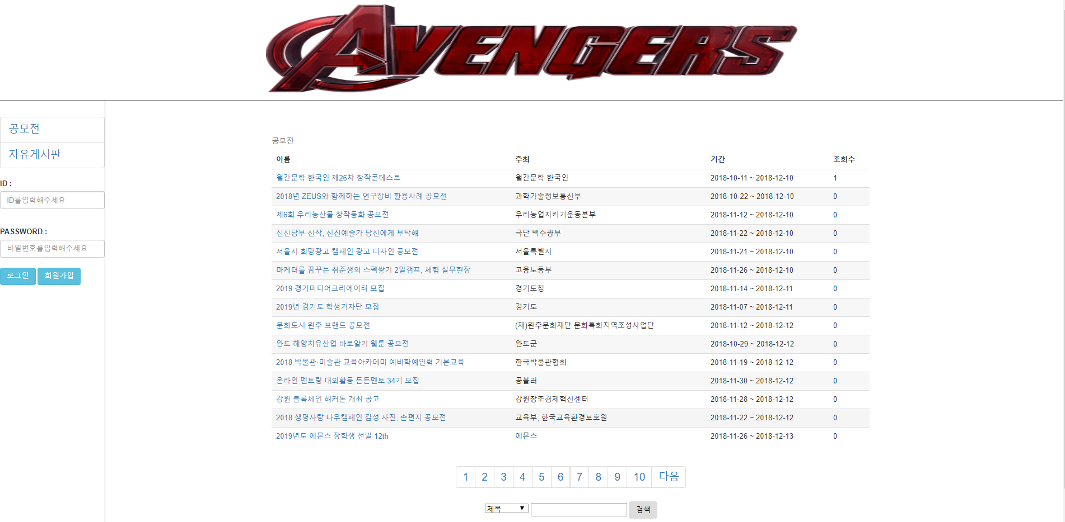
2
System structure

Slide 14
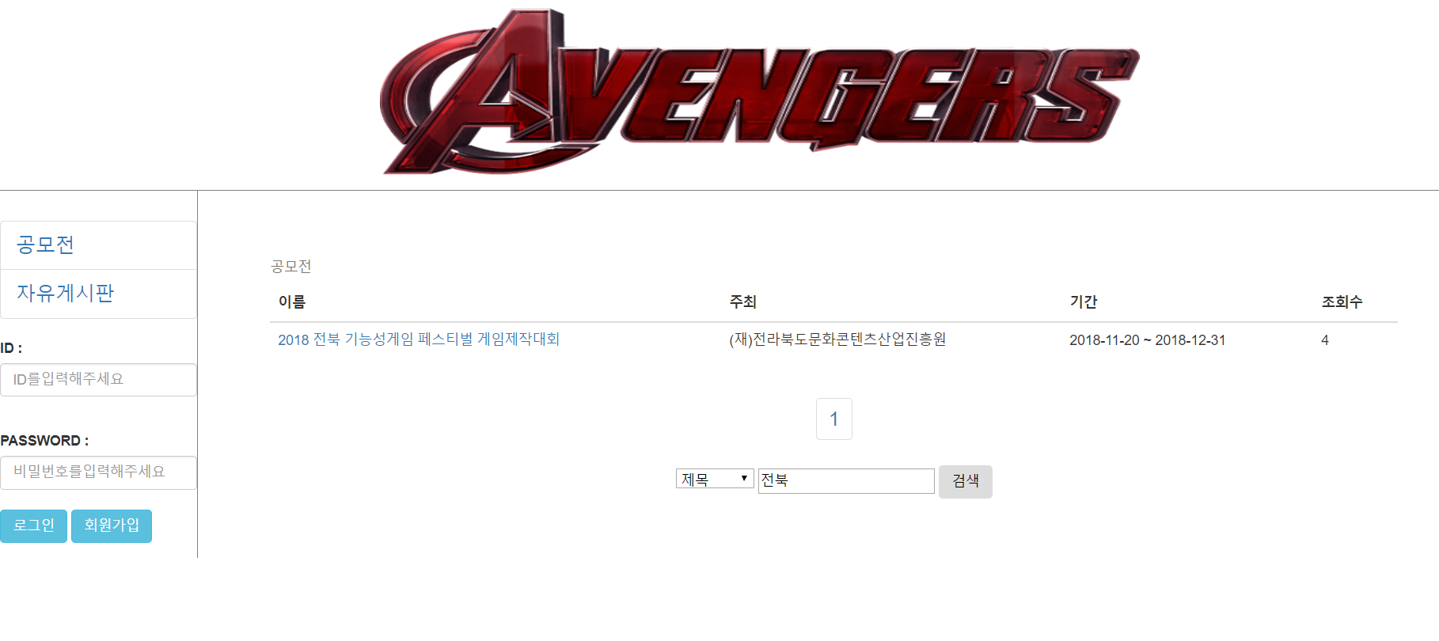
2
System structure

Slide 15
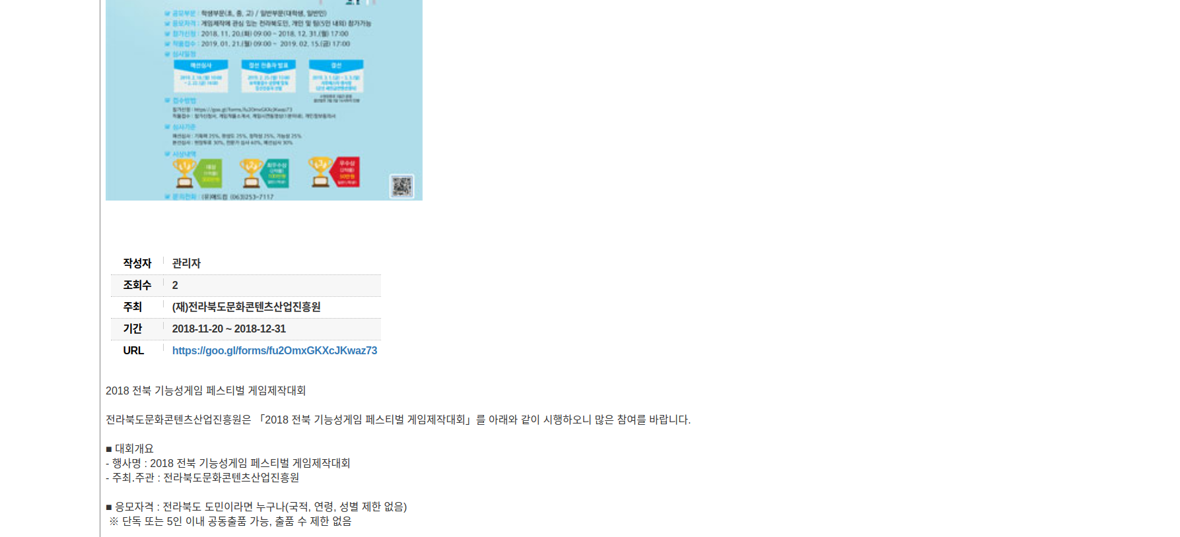
2
System structure

Slide 16
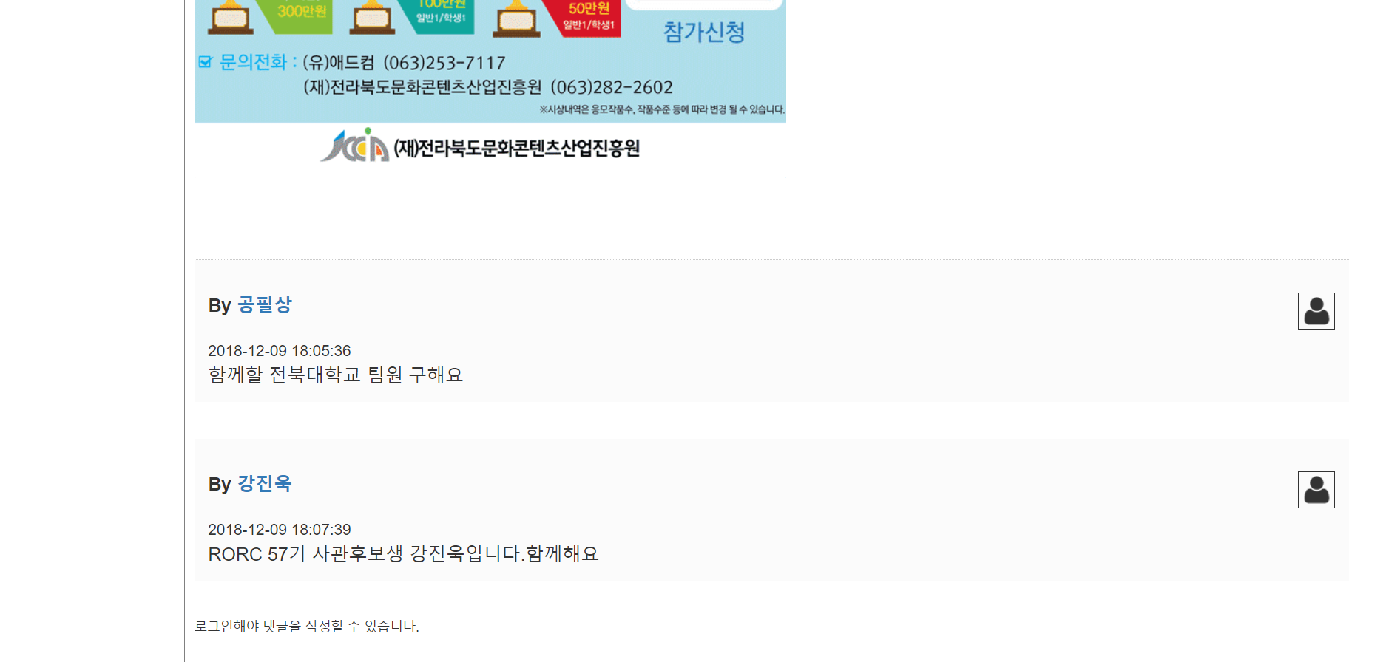
2
System structure

Slide 17
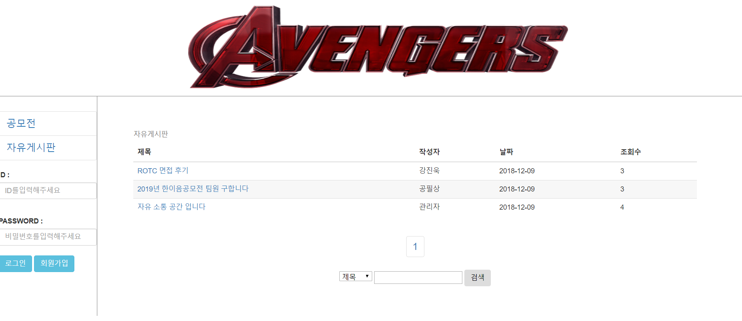
2
System structure

Slide 18
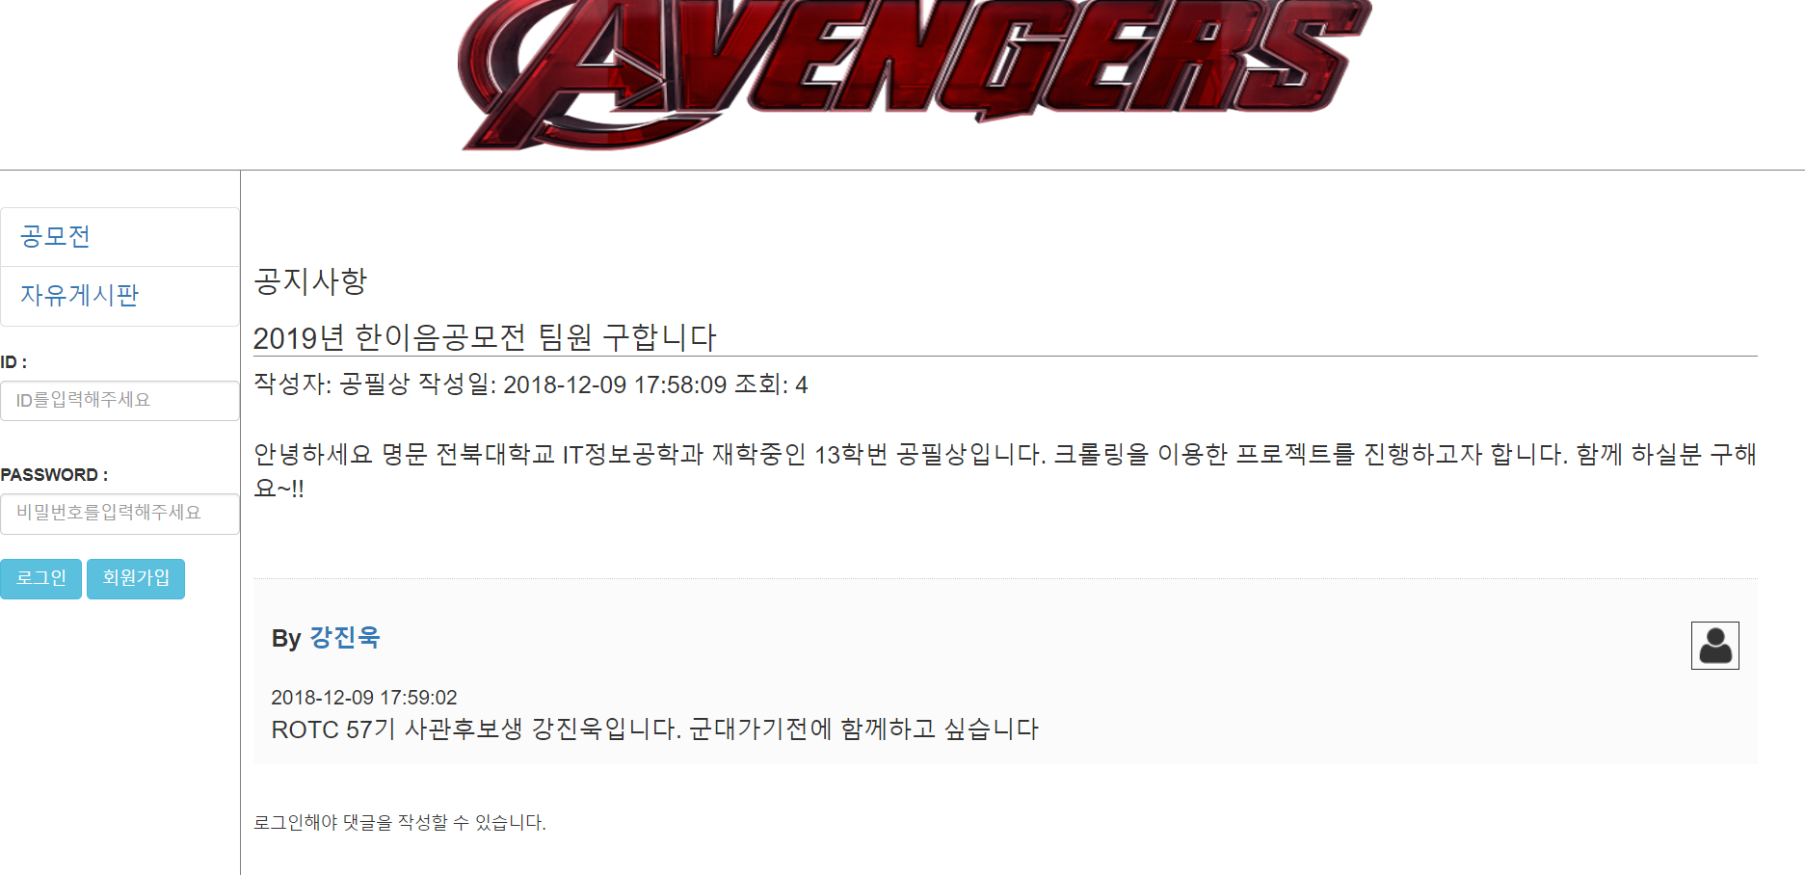
2
System structure

Slide 19
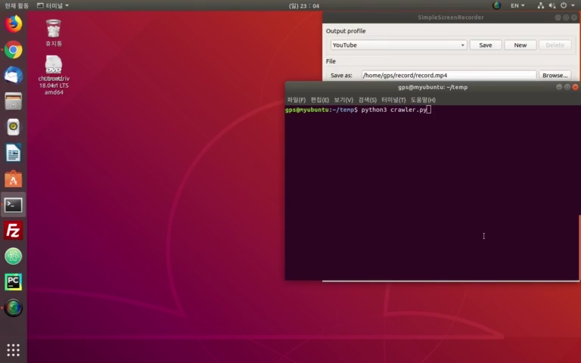
2
System structure

Slide 20
3
Development Environment
OS : Linux
WebServer : Apache
Datebase : MySQL
Language : PHP, Python
Github : https://github.com/gofeel8/avengers
Homepage : http://210.117.181.21/termprj/s201315164/crawling/index.php

Slide 21
Thank you
Q & A

